Slide 1
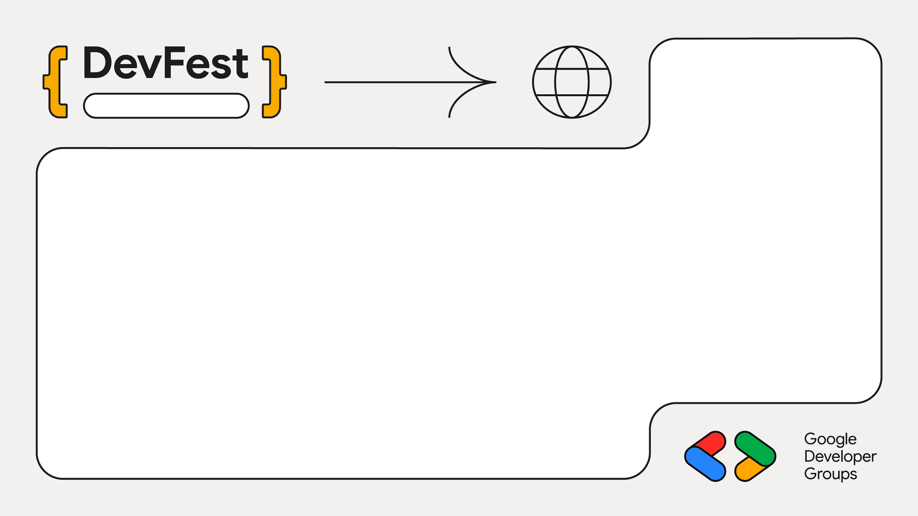
2025
Bengaluru
From Cloud to Pocket: Refining Stories with Google’s Gemini API and Gemma On-Device Model
Mayur Madnani

Slide 2
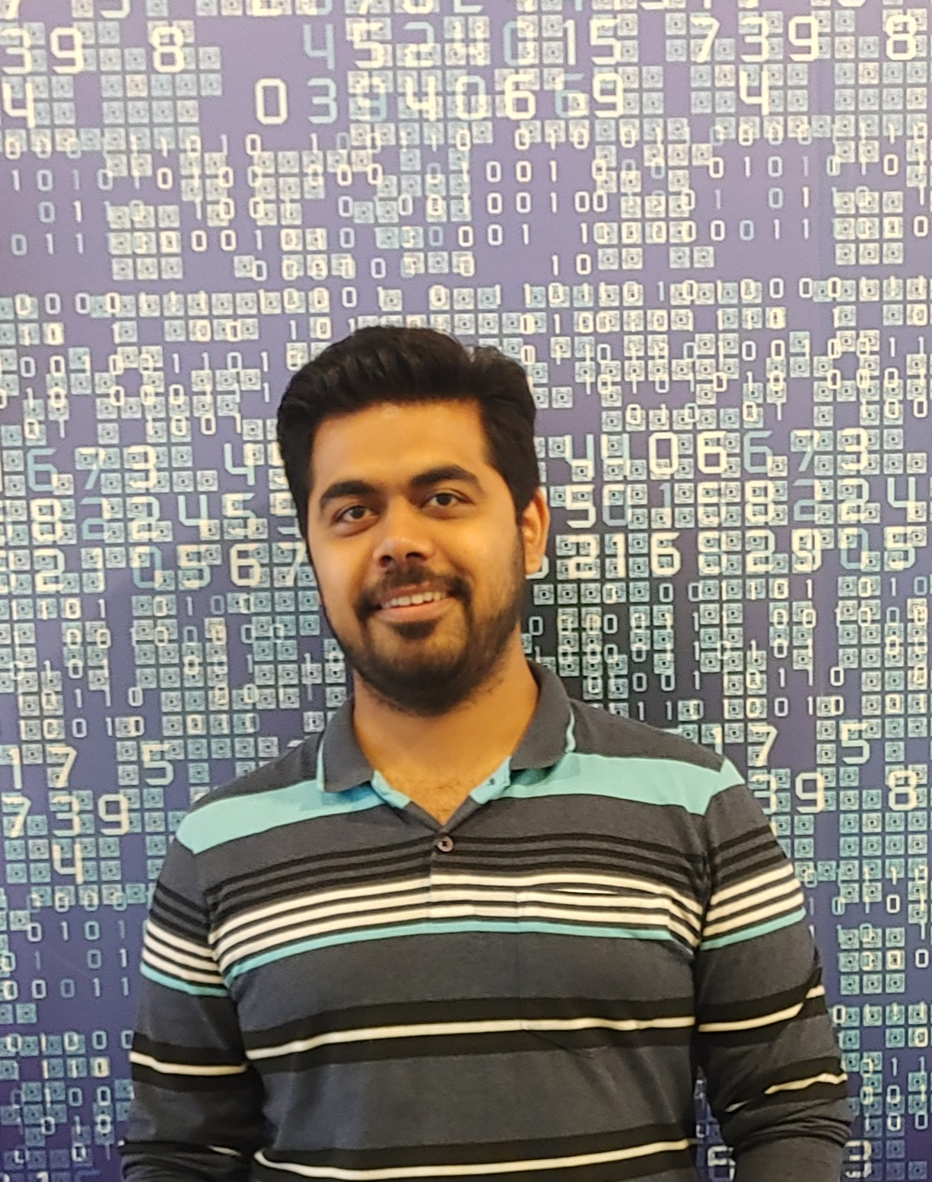
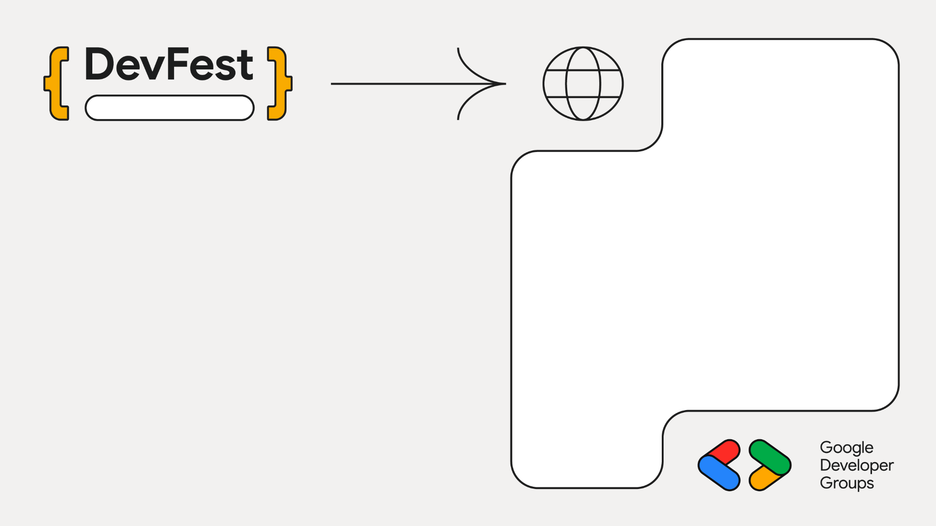
Bengaluru
Staff Engg @ JioHotstar
Previously @ Intuit, Walmart, SAP
Expertise in Data, AI and Backend
~10 years in the Industry
GenAI Course Author
Mayur Madnani

Slide 3
“Bigger is better” to “Efficient and specific”
Feature | LLM | SLM
Philosophy | One model to rule them all | Right tool for the right job
Scale | Massive parameters (100B+) | Compact & Efficient (<10B)
Focus | General purpose versatility | Domain precision & Agentic workflows
Resources | Requires data center clusters | Runs on consumer GPUs/edge devices
Outcome | Raw Knowledge Capability | Privacy, Speed, and ROI

Slide 4
The Generalist Problem
Domain Mismatch
Struggle in specialized fields
Static Knowledge
Real time information & context
Deployment Constraints
Cost and Practicality

Slide 5
Model Adaptation
Technique | Use Cases | Cost
Prompt Engineering | Guided reasoning without training
Parametric (Full) | Complete retraining
Semi-Parametric | Injecting live facts/documents
Parametric (Efficient) | Updating specific skills

Slide 6
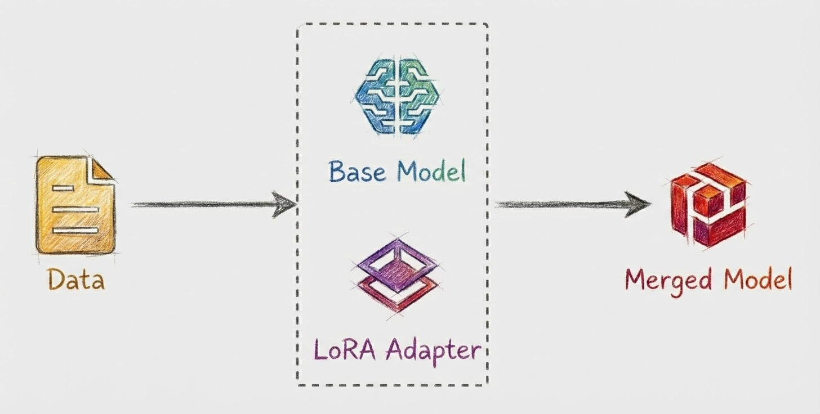
Low-Rank Adaptation (LoRA)

Slide 7
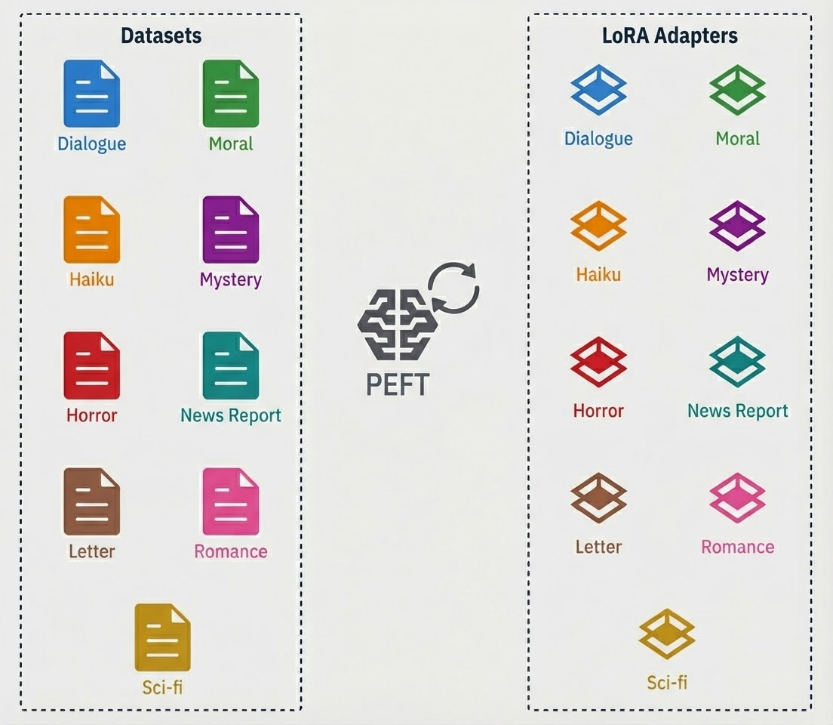
LoRA Adapters

Slide 8
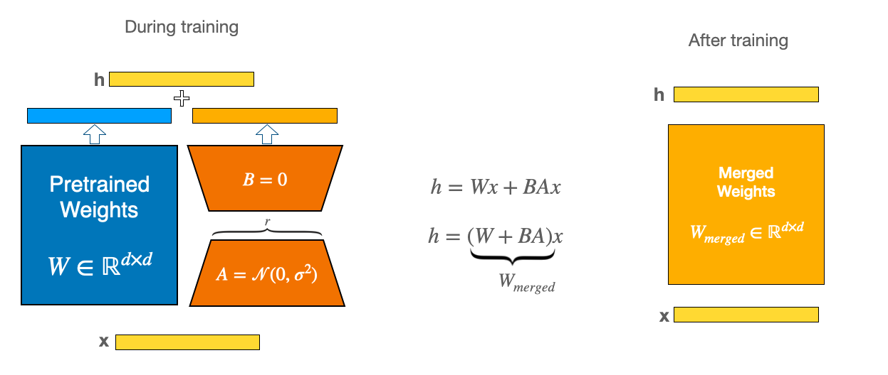
Low-Rank Adaptation (LoRA)

Slide 9




Key Takeaways
1
Shift from Giants to Specialists
2
Scaling down for practical utility
3
Adaptation- Jack of all trades into a Master of One
4
The Modular Ecosystem

Slide 10

LinkedIn
https://linkedin.com/in/mayurmadnani

Slide 11
Time for Action
LET US BUILD
LAPTOPS OUT

Slide 12

Workshop
https://github.com/mayurmadnani/MicroFables

